Slide 1


Computer Networks
Lectures (Chapter4)
Network Layer: Data Plane
Subhan Ullah, PhD
subhan.ullah@nu.edu.pk
BS(Computer Science) Spring-2024

Slide 2
Network layer: our goals
understand principles behind network layer services, focusing on data plane:
network layer service models
forwarding versus routing
how a router works
addressing
generalized forwarding
Internet architecture
instantiation, implementation in the Internet
IP protocol
Network Address Translation (NAT)

Slide 3

Network layer: “data plane” roadmap
Network layer: overview
data plane
control plane
What’s inside a router
input ports, switching, output ports
buffer management, scheduling
IP: the Internet Protocol
datagram format
addressing
network address translation
IPv6

Slide 4
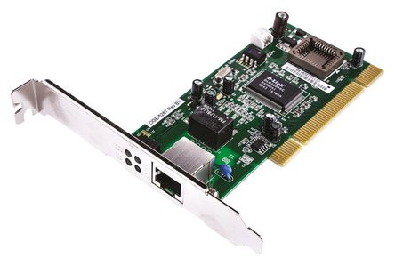
Interfaces
The boundary between the host/router and the physical link is called an interface
A host typically has only a single link into the network, a single interface
Router necessarily has two or more links to which it is connected, multiple interfaces
IP requires each host and router interface to have its own IP address

Slide 5
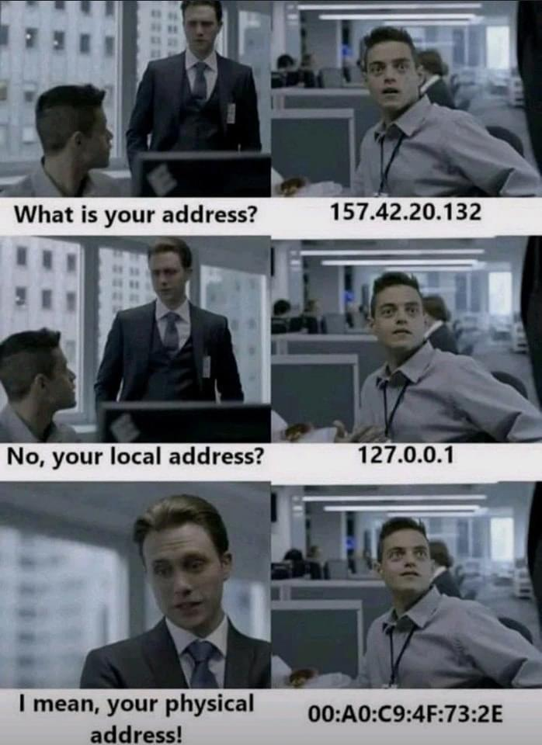
If you are a Network Engineer ☺

Slide 6
What is an Address?
An identifier which includes information about how to find its subject
(according to some rules of interpretation)
Normally hierarchical
Each part provides more specific detail
For example
+92 51 111128128
Internet identifier including information about how to reach a network location
(via the Internet routing system)
As similar to actual addresses, different parts of IP address serve different purpose

Slide 7

IP addressing: introduction
223.1.1.1
IP address: 32-bit identifier associated with each host or router interface
interface: connection between host/router and physical link
router’s typically have multiple interfaces
host typically has one or two interfaces (e.g., wired Ethernet, wireless 802.11)
223.1.2.1
223.1.1.2
223.1.1.4
223.1.2.9
223.1.1.3
223.1.3.27
223.1.2.2
223.1.3.1
223.1.3.2
dotted-decimal IP address notation:
223.1.1.1 = 11011111 00000001 00000001 00000001
223
1
1
1

Slide 8
IP addressing: introduction
223.1.1.1
IP address: 32-bit identifier associated with each host or router interface
interface: connection between host/router and physical link
router’s typically have multiple interfaces
host typically has one or two interfaces (e.g., wired Ethernet, wireless 802.11)
223.1.2.1
223.1.1.2
223.1.1.4
223.1.2.9
223.1.1.3
223.1.3.27
223.1.2.2
223.1.3.1
223.1.3.2
dotted-decimal IP address notation:
223.1.1.1 = 11011111 00000001 00000001 00000001
223
1
1
1

Slide 9

IP addressing: introduction
223.1.1.1
Q: how are interfaces actually connected?
223.1.2.1
223.1.1.2
A: we’ll learn about that in chapters 6, 7
A: wired
Ethernet interfaces connected by Ethernet switches
223.1.1.4
223.1.2.9
223.1.1.3
223.1.3.27
223.1.2.2
223.1.3.1
223.1.3.2
For now: don’t need to worry about how one interface is connected to another (with no intervening router)
A: wireless WiFi interfaces connected by WiFi base station

Slide 10
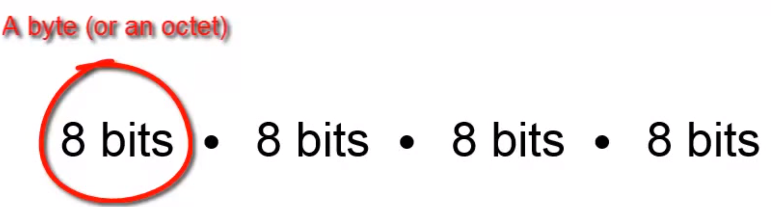
Dotted Decimal Notation
IP addresses are written in a so-called dotted decimal notation
Each byte is identified by a decimal number in the range [0..255]:
Example
IPv4 Address
10000000
10001111
10001001
10010000
1st Byte
= 128
2nd Byte
= 143
3rd Byte
= 137
4th Byte
= 144
128.143.137.144

Slide 11
IPv4 address conversion
Example
10000001.00001011.00000011.01110011
129 . 11 . 3 . 115
Find the error, if any, in the following IP addresses
129 . 56 . 034 . 115
129 . 56 . 34 . 11 .115
129 . 301 . 34 . 115
10001100 . 56 . 034 . 115

Slide 12
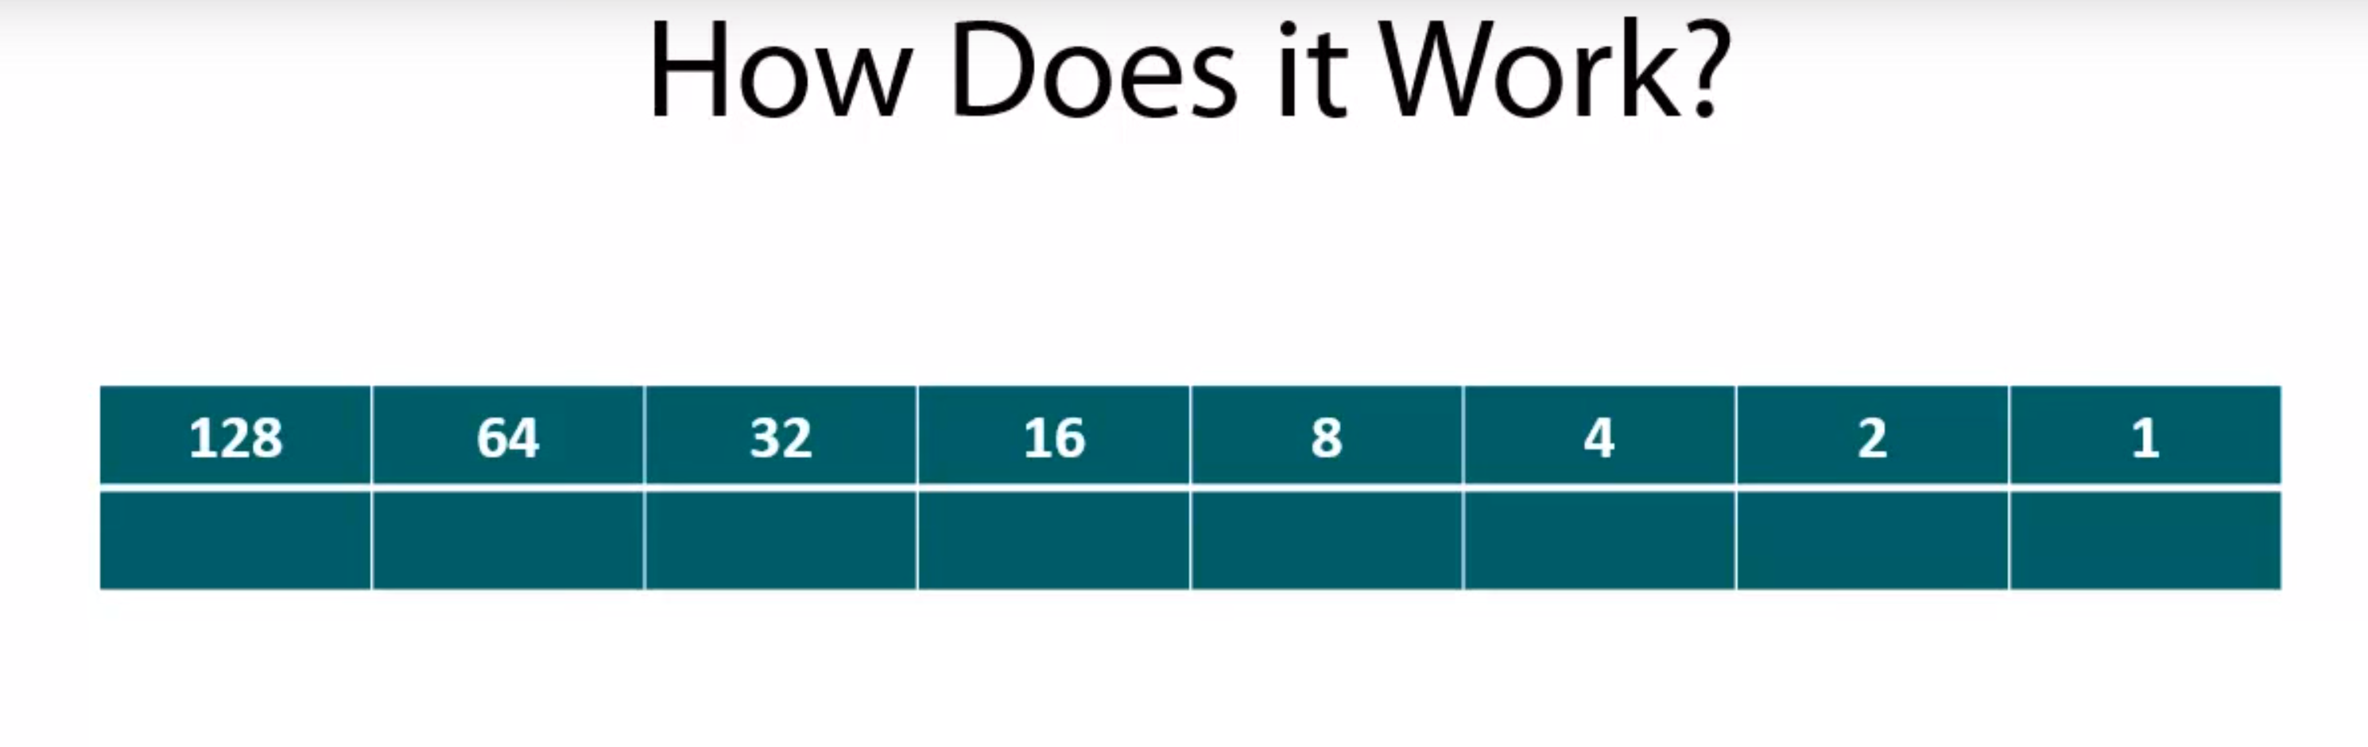
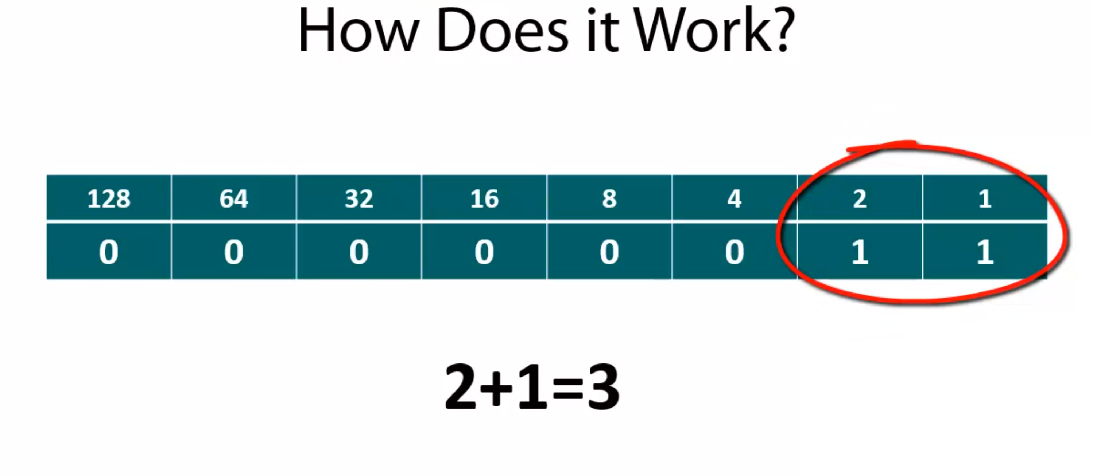
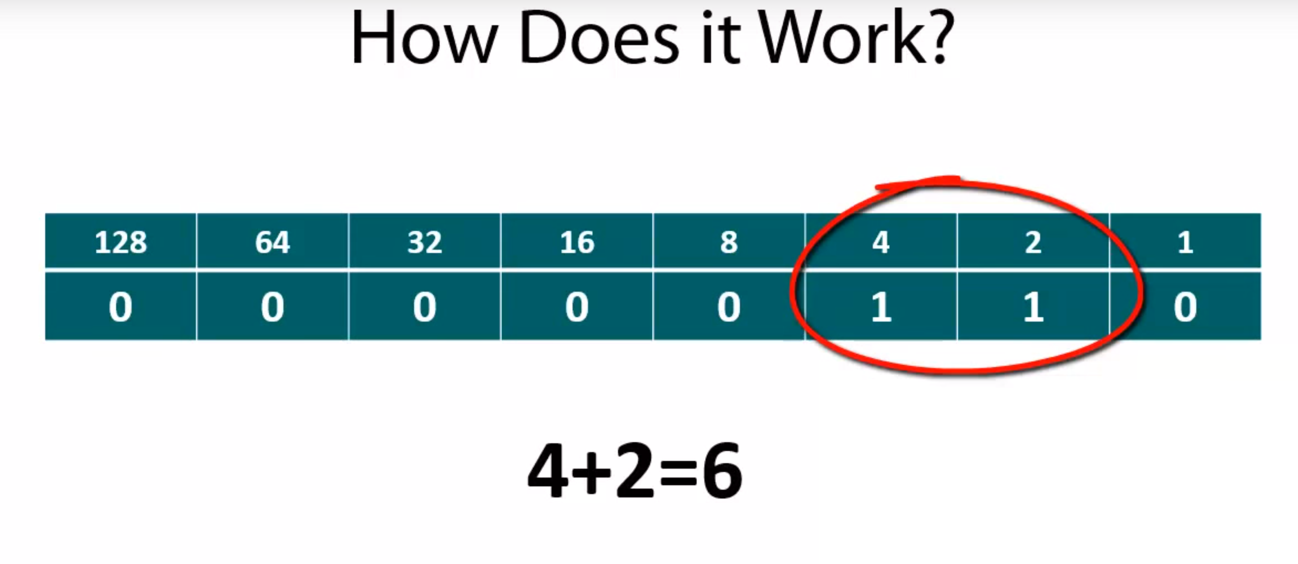
IPv4 address
How does it work?
1+2 = 3
4+2 = 6

Slide 13
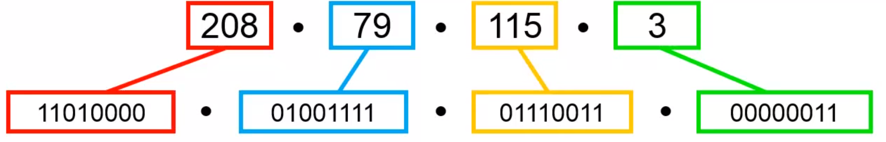
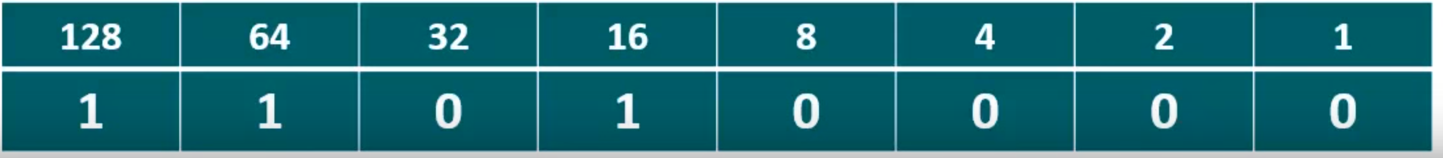
IPv4 address
Converting IP addresses to binary (base 2)

Slide 14
Telephone Network Routing
Global
Prefix Table
+1 +44 +61 +886 +92 …
+92 51 111128128
Prefix Table
2 21 51 …
National
+92
Prefix Table
…
Local
51
111111128

Slide 15
Internet Address Routing
Global Routing Table
4.128/9 60.100/16 60.100.0/20 135.22/16 202.12.29.0/24 …
The Internet
Announce
202.12.29.0/24
Traffic
202.12.29.0/24
202.12.29.0/24

Slide 16
Internet Address Routing
Traffic
202.12.29.142
Local Routing Table
202.12.29.0/25 202.12.29.128/25
Local Router
202.12.29.142
202.12.29.0/24

Slide 17
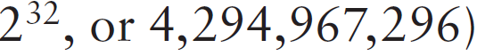
IP Addressing Components
32 bits
Network ID
Host ID
Example: ellington.cs.virginia.edu
128.143
137.144
Network address is: 128.143.0.0 (or 128.143)
Host number is: 137.144
Note: Hierarchical addressing handle large number of addresses: Namely 4.3 billion ( a 32-bit address space
with two possible values for each position: either 0 or 1 gives
Notes:
Section E: Covered (09-12-2021)

Slide 18
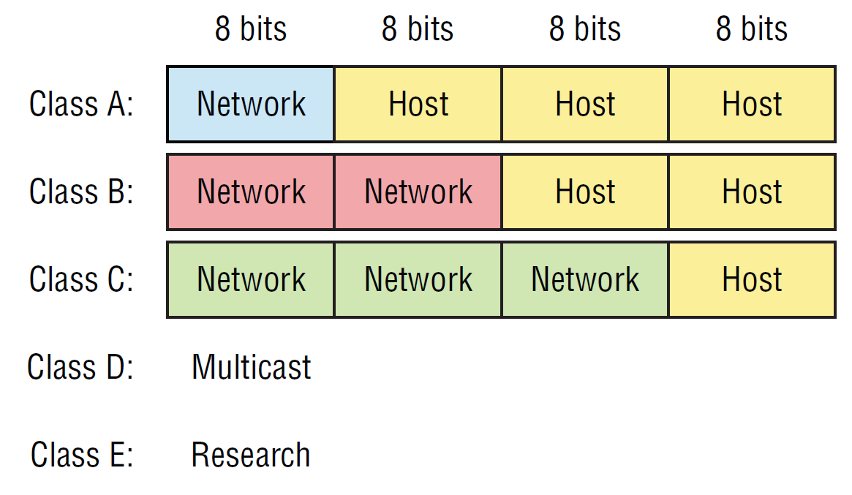
Classful IP Adresses (Until 1993)
When Internet addresses were standardized (early 1980s), the Internet address space was divided up into classes:

Slide 19
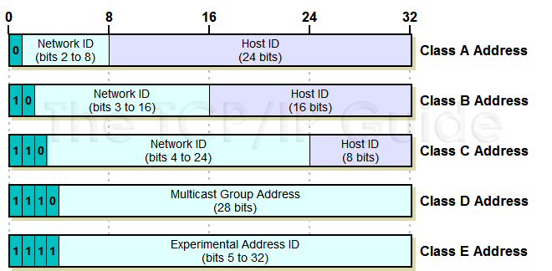
Identification of the class of address
http://www.tcpipguide.com/free/t_IPClassfulAddressingNetworkandHostIdentificationan-3.htm
Notes:
Section D covered: (08-12-2021)

Slide 20
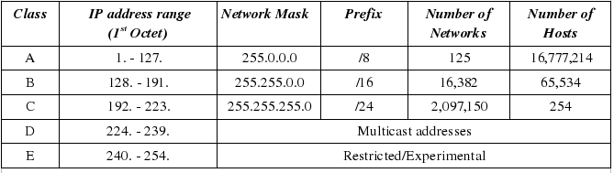
IP address ranges and number networks/hosts
7
https://www.telecomworld101.com/Classes.html
Notes:
Class D has IP address range from 224.0.0.0 to 239.255.255.255. Class D is reserved for Multicasting. In multicasting data is not destined for a particular host, that is why there is no need to extract host address from the IP address, and Class D does not have any subnet mask.
A router will determine if any of the hosts on a locally attached network are configured to receive multicast datagrams using IGMP( Internet Group Management Protocol).
Class E IP address is reserved for experimental purposes only for R&D or Study. IP addresses in this class ranges from 240.0.0.0 to 255.255.255.254. Like Class D, this class too is not equipped with any subnet mask.

Slide 21
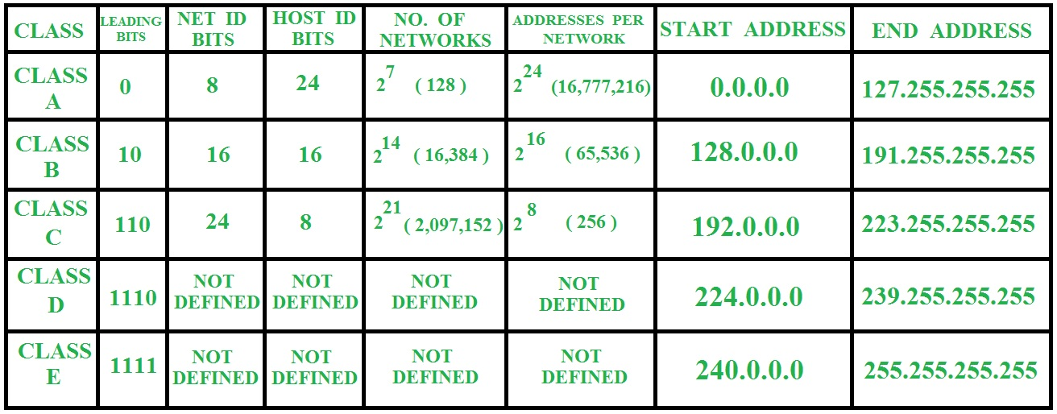
Summary of Classfull addressing
https://www.geeksforgeeks.org/introduction-of-classful-ip-addressing/

Slide 22
Public and private IP address ranges
Class | Private IP addresses Range | Public IP address range
A | 10.0.0.0—10.255.255.255 | 1.0.0.0—9.255.255.255 11.0.0.0– 126.255.255.255
B | 172.16.0.0 – 172.31.255.255 | 128.0.0.0– 172.15.255.255 172.32.0.0—191.225.255.255
C | 192.168.0.0– 192.168.255.255 | 192.0.0.0– 192.167.255.255 192.169.0.0 – 223.225.255.255
How to remember the private addresses ranges?
Class A: 10.x.x.x
Class B: 172.16.x.x—172.31.x.x
Class C: 192.168.x.x
Notes:
Section F: Covered ; 10-12-2021

Slide 23
IP address types
Loopback (localhost): Used to test the IP stack on the local computer. Can be any address from 127.0.0.1 through 127.255.255.254
Layer 2 broadcasts (Hardware broadcast: 48 bits): These are sent to all nodes on a LAN
Broadcasts (layer 3): These are sent to all nodes on the network
Unicast: This is an address for a single interface, and these are used to send packets to a single destination host
Multicast: These are packets sent from a single source and transmitted to many devices on different networks. Referred to as “one-to-many”

Slide 24
Special IP Addresses
Reserved or (by convention) special addresses:
Loopback interfaces
all addresses 127.0.0.1-127.255.255.255 are reserved for loopback interfaces
Most systems use 127.0.0.1 as loopback address
loopback interface is associated with name “localhost”
Broadcast address
Host number is all ones, e.g., 128.143.255.255
Broadcast goes to all hosts on the network
Often ignored due to security concerns
IP address of a network
Host number is set to all zeros, e.g., 128.143.0.0
Test / Experimental addresses Certain address ranges are reserved for “experimental use”. Packets should get dropped if they contain this destination address (see RFC 1918):
Convention (but not a reserved address)
Default gateway has host number set to ‘1’, e.g., 192.0.1.1

Slide 25
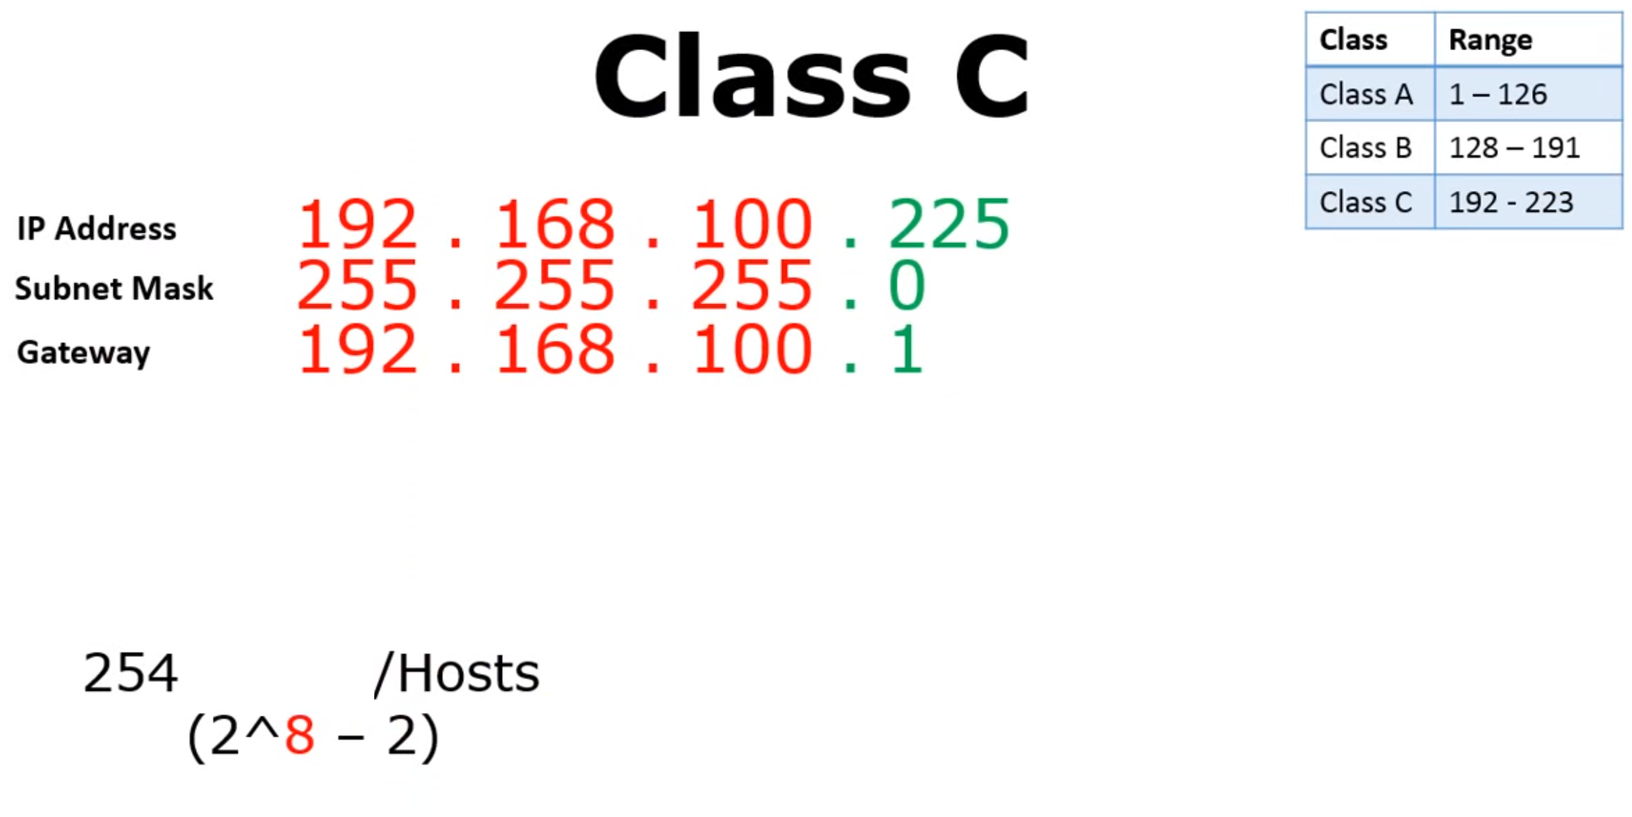
Class | Range
Class A | 1-127
Class B | 128-191
Class C | 192-223
The gateway address (or default gateway) is a router interface connected to the local network that sends packets out of the local network. The gateway has a physical and a logical address.
The subnet mask tells you which portion is the network which requires an understanding of the binary representation of the decimal values.

Slide 26
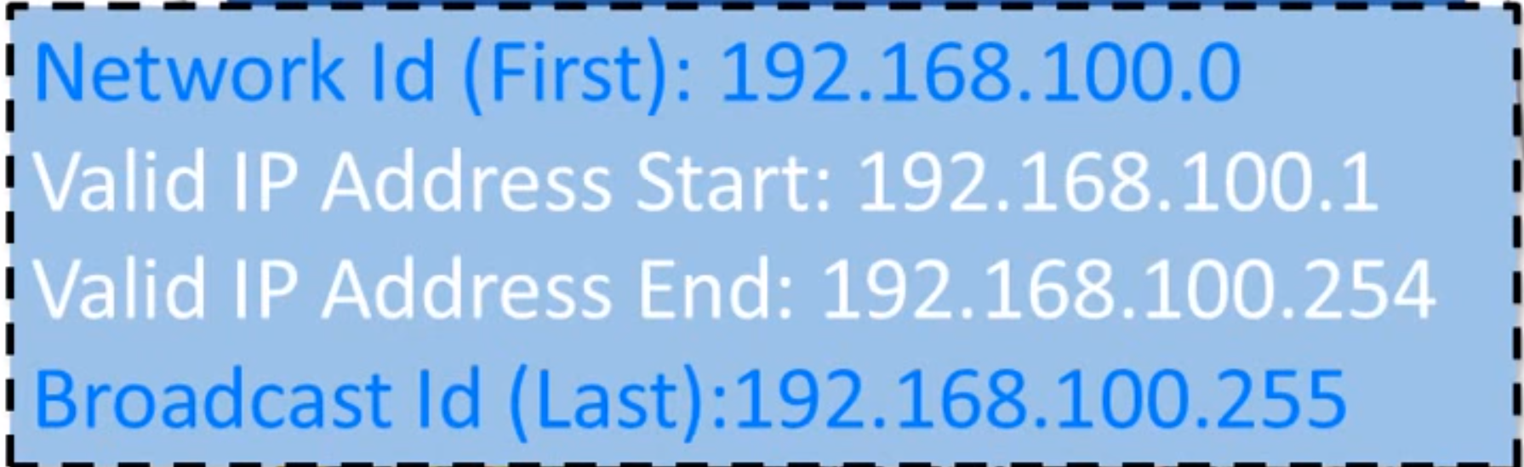
Class | Range
Class A | 1-127
Class B | 128-191
Class C | 192-223
11111111-11111111-11111111-00000000
/24

Slide 27
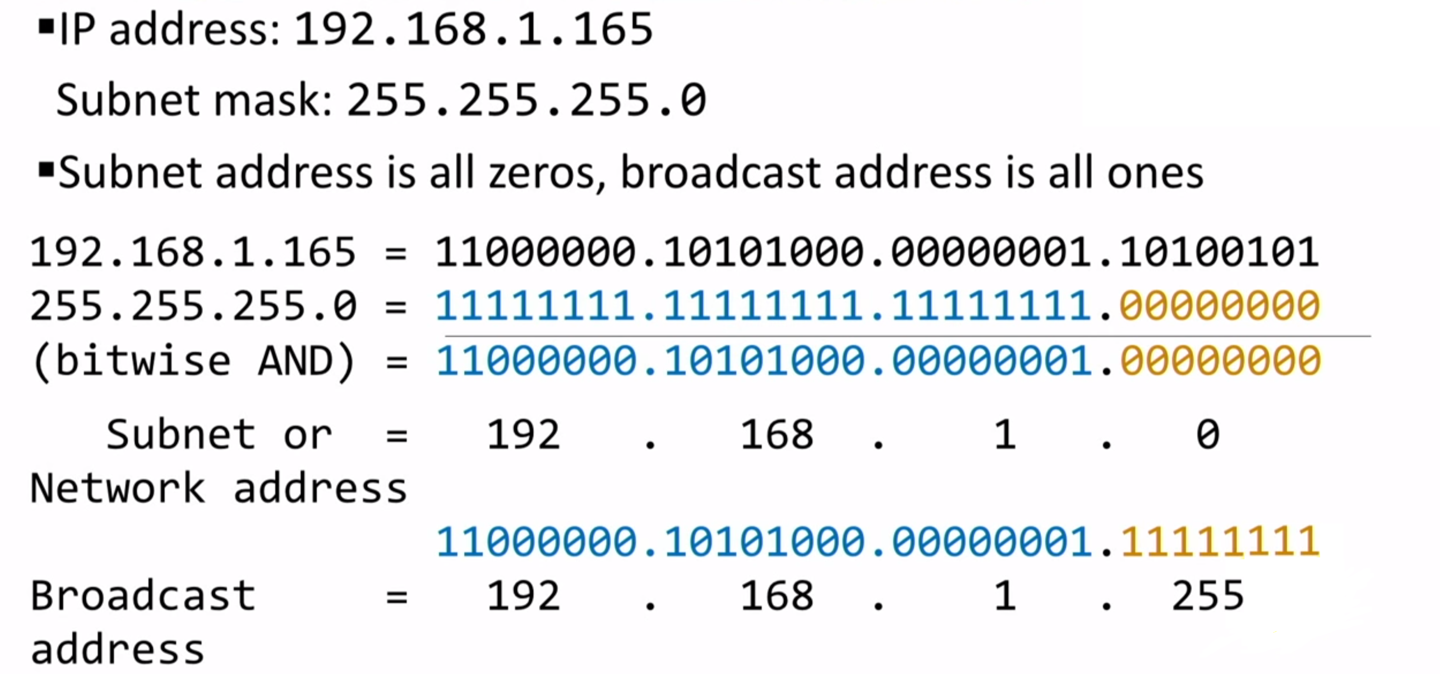
Network address and Broadcast address

Slide 28
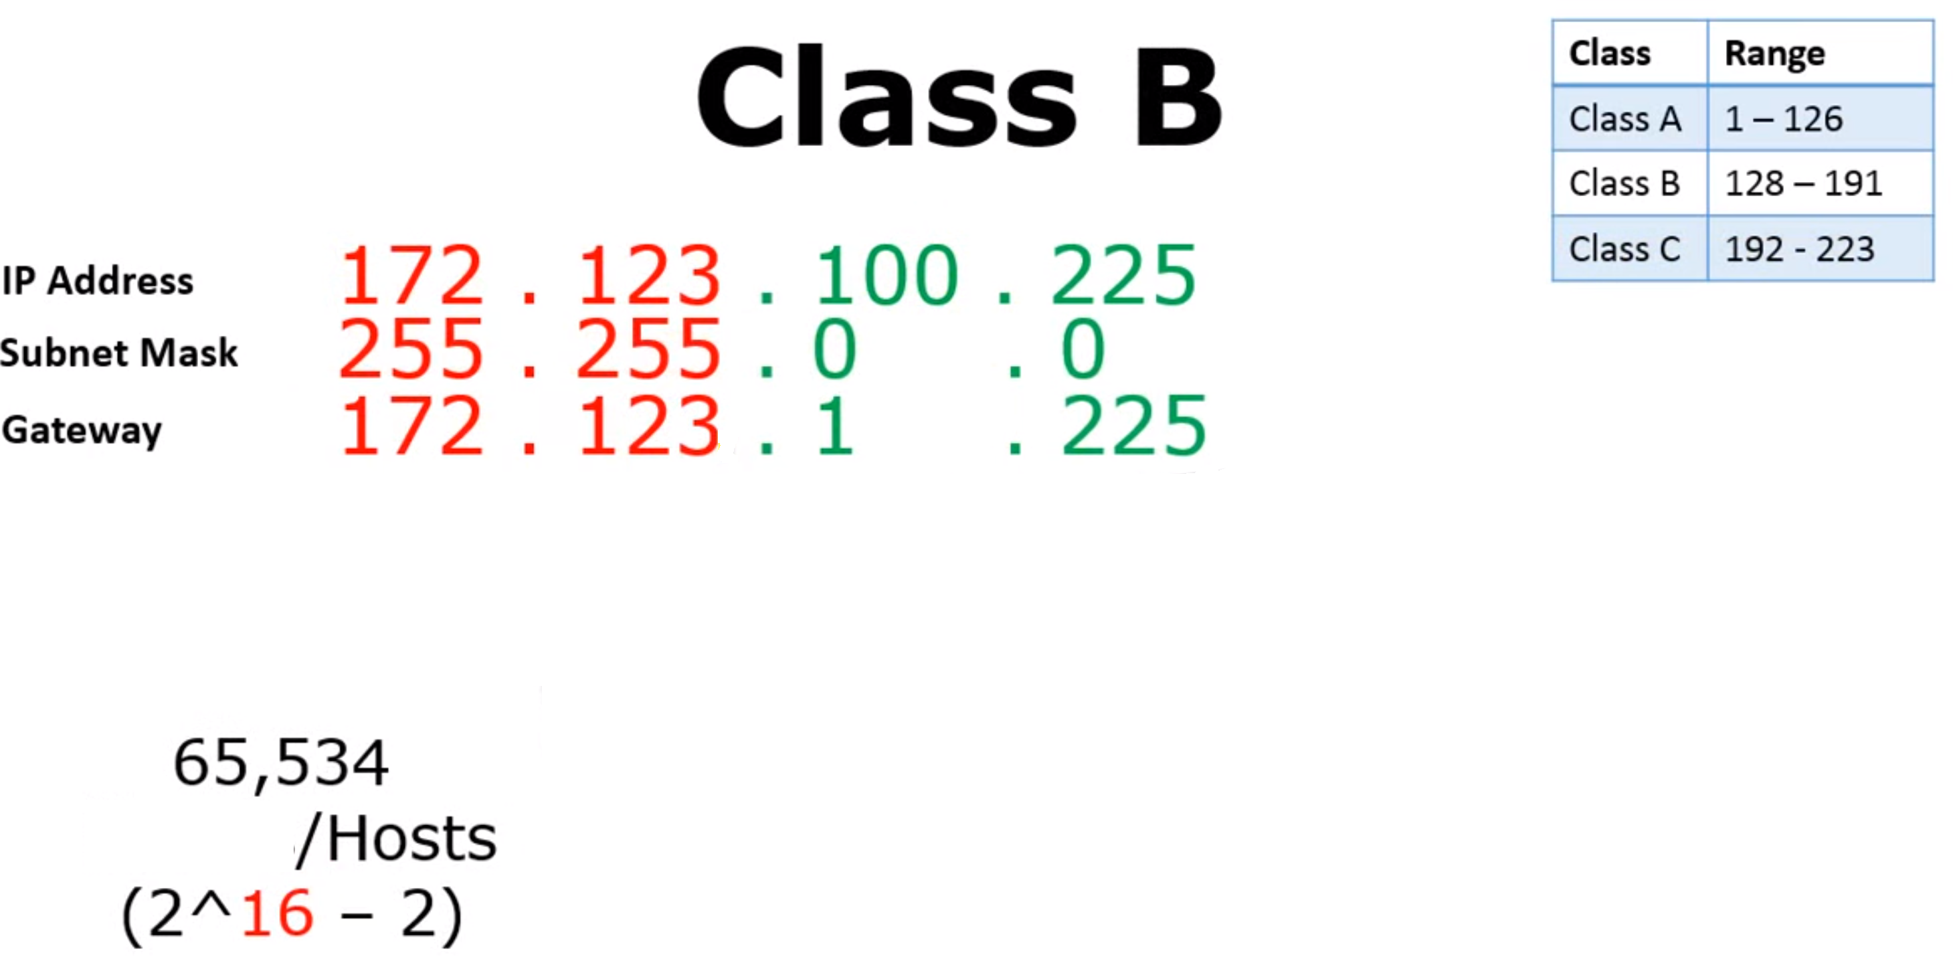
Class | Range
Class A | 1-127
Class B | 128-191
Class C | 192-223

Slide 29
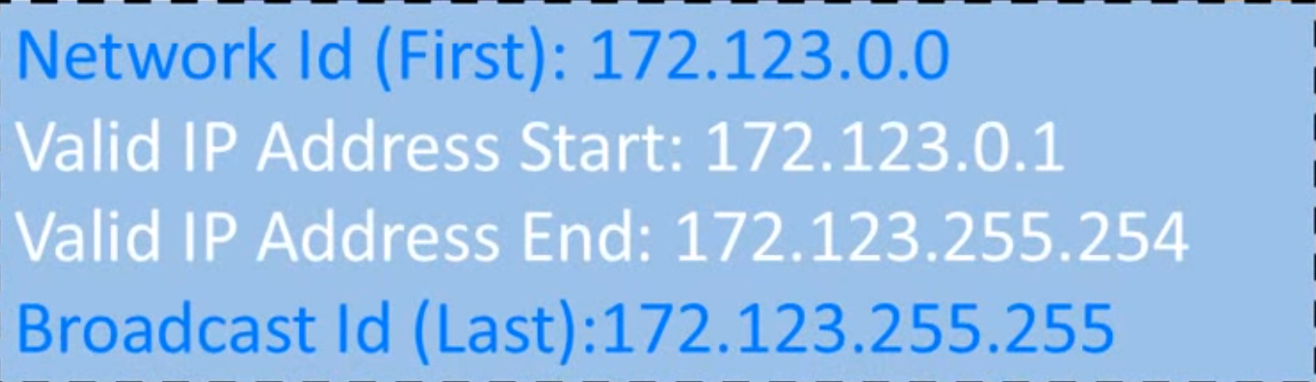
Class | Range
Class A | 1-127
Class B | 128-191
Class C | 192-223
/16

Slide 30
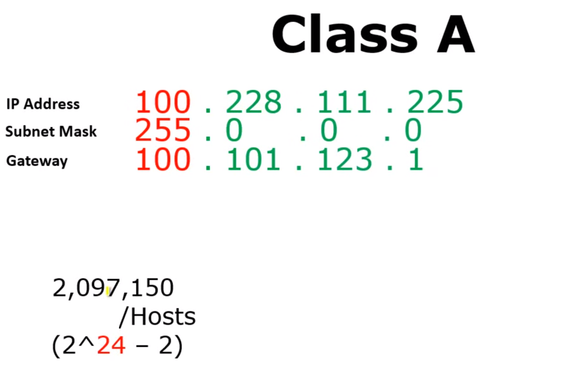
Class | Range
Class A | 1-127
Class B | 128-191
Class C | 192-223
/8

Slide 31
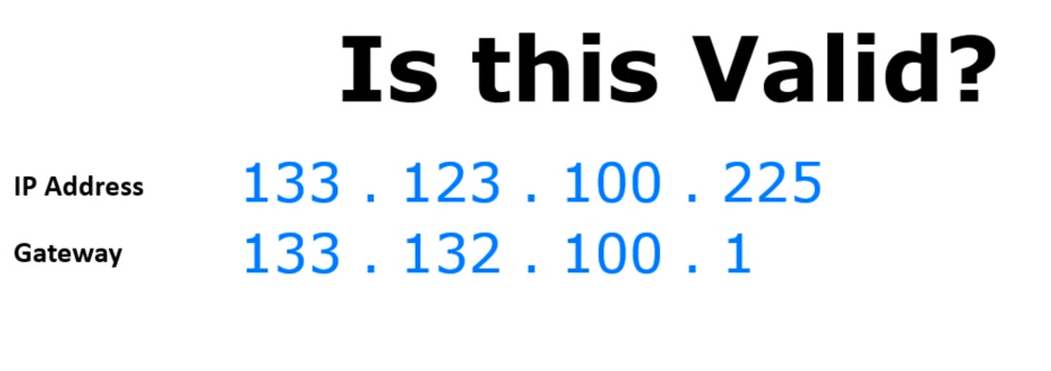
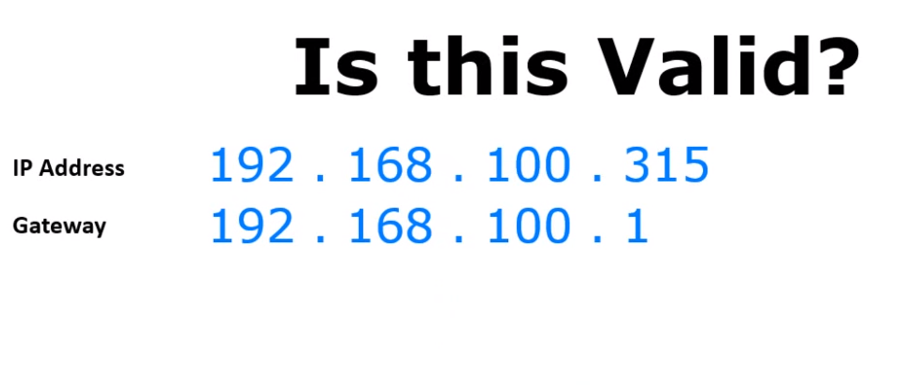
Class | Range
Class A | 1-127
Class B | 128-191
Class C | 192-223
X
X

Slide 32
Problems with Classful IP Addresses
By the early 1990s, the original classful address scheme had a number of problems
Flat address space
Routing tables on the backbone Internet need to have an entry for each network address
When Class C networks were widely used, this created a problem
By the 1993, the size of the routing tables started to outgrow the capacity of routers
Other problems:
Too few network addresses for large networks
Class A and Class B addresses were gone
Limited flexibility for network addresses:
Class A and B addresses are overkill (>64,000 addresses)
Class C address is insufficient

Slide 33
CIDR vs Class based addressing
How do we know how long the network prefix is?
Before 1993: The network prefix is implicitly defined (see class-based addressing)
OR
After 1993: The network prefix is indicated by CIDR (Classless Inter-Domain Routing) and netmask

Slide 34
Classless Interdomain Routing (CIDR)
The 32-bit IP address is divided into two parts and has the dotted-decimal form a.b.c.d/x
x indicates the number of bits in network part of address
The x most significant bits constitute the network portion of the IP address, called prefix (or network prefix)
An organization is typically assigned a block of contiguous addresses, that is, a range of addresses with a common prefix
In this case, the IP addresses of devices within the organization will share the common prefix
Only these x leading prefix bits are considered by routers outside the organization’s network

Slide 35
Classless Interdomain Routing
This reduces the size of the forwarding table in these routers
a single entry of the form a.b.c.d/x will be sufficient to forward packets to any destination within the organization.
What about the remaining 32-x bits?
The remaining (32 – x) bits of an address can be thought of as distinguishing among the devices within the organization,
All of which have the same network prefix
These are the bits that will be considered when forwarding packets at routers within the organization

Slide 36
CIDR and Routing Information
Company X :
206.0.68.0/22
ISP X owns:
206.0.64.0/18
204.188.0.0/15
209.88.232.0/21
Internet Backbone
ISP y :
209.88.237.0/24
Organization z1 :
209.88.237.192/26
Organization z2 :
209.88.237.0/26

Slide 37
CIDR and Routing Information
Backbone routers do not know anything about Company X, ISP Y, or Organizations z1, z2.
Company X :
206.0.68.0/22
ISP X owns:
ISP X does not know about Organizations z1, z2.
ISP y sends everything which matches the prefix: 209.88.237.192/26 to Organizations z1 209.88.237.0/26 to Organizations z2
206.0.64.0/18
204.188.0.0/15
209.88.232.0/21
Internet Backbone
ISP X sends everything which matches the prefix: 206.0.68.0/22 to Company X,
209.88.237.0/24 to ISP y
ISP y :
209.88.237.0/24
Backbone sends everything which matches the prefixes 206.0.64.0/18, 204.188.0.0/15, 209.88.232.0/21 to ISP X.
Organization z1 :
209.88.237.192/26
Organization z2 :
209.88.237.0/26

Slide 38
Obtaining a Block of Addresses
Network administrator might first contact its ISP, which would provide addresses from a larger block of addresses that had already been allocated to the ISP
Example:
The ISP may itself have been allocated the address block 200.23.16.0/20.
Suppose a client requires 800 host addresses
The ISP, in turn, could divide its address block into eight equal-sized contiguous address blocks and give one of these address blocks out to each of up to eight organizations that are supported by this ISP

Slide 39
IP addressing: CIDR
CIDR: Classless InterDomain Routing (pronounced “cider”)
subnet portion of address of arbitrary length
address format: a.b.c.d/x, where x is # bits in subnet portion of address
subnet
part
host
part
11001000 00010111 00010000 00000000
200.23.16.0/23

Slide 40
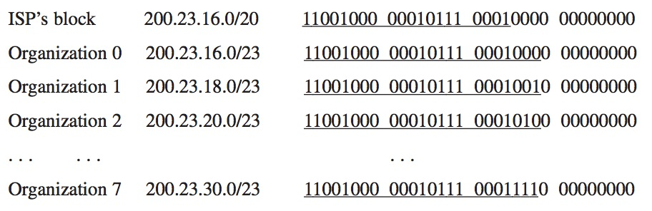
CIDR and Address assignments

Slide 41
Subnets
223.1.1.1
What’s a subnet ?
device interfaces that can physically reach each other without passing through an intervening router
223.1.2.1
223.1.1.2
223.1.1.4
223.1.2.9
223.1.1.3
223.1.3.27
223.1.2.2
IP addresses have structure:
subnet part: devices in same subnet have common high order bits
host part: remaining low order bits
223.1.3.1
223.1.3.2
network consisting of 3 subnets

Slide 42
Subnets
subnet 223.1.1.0/24
223.1.1.1
subnet 223.1.2.0/24
Recipe for defining subnets:
detach each interface from its host or router, creating “islands” of isolated networks
each isolated network is called a subnet
223.1.2.1
223.1.1.2
223.1.1.4
223.1.2.9
223.1.1.3
223.1.3.27
223.1.2.2
subnet
223.1.3.0/24
223.1.3.1
223.1.3.2
subnet mask: /24
(high-order 24 bits: subnet part of IP address)

Slide 43
Subnets
223.1.1.2
subnet 223.1.1/24
where are the subnets?
what are the /24 subnet addresses?
223.1.1.1
223.1.1.4
223.1.1.3
223.1.9.2
223.1.7.2
subnet 223.1.7/24
subnet 223.1.9/24
223.1.9.1
223.1.7.1
223.1.8.1
223.1.8.2
subnet 223.1.2/24
223.1.2.6
subnet 223.1.8/24
223.1.3.27
subnet 223.1.3/24
223.1.2.1
223.1.2.2
223.1.3.1
223.1.3.2

Slide 44
Subnetting
Problem: Organizations have multiple networks which are independently managed
Solution 1: Allocate a separate network address for each network
Difficult to manage
From the outside of the organization, each network must be addressable
Solution 2: Add another level of hierarchy to the IP addressing structure
University Network
Engineering
School
Medical
School
Library
Subnetting

Slide 45
Address assignment with subnetting
Each part of the organization is allocated a range of IP addresses (subnets or subnetworks)
Addresses in each subnet can be administered locally
IP addresses are managed under the authority of the Internet Corporation for Assigned Names and Numbers (ICANN)
University Network
128.143.0.0/16
128.143.71.0/24 128.143.136.0/24
Engineering
School
Medical
School
128.143.56.0/24
Library
128.143.121.0/24

Slide 46
Basic Idea of Subnetting
Split the host number portion of an IP address into a subnet number and a (smaller) host number.
Result is a 3-layer hierarchy
network prefix
host number
network prefix
subnet number
host number
extended network prefix
Then:
Subnets can be freely assigned within the organization Internally,
Subnets are treated as separate networks
Subnet structure is not visible outside the organization
Notes:
Class D has IP address range from 224.0.0.0 to 239.255.255.255. Class D is reserved for Multicasting. In multicasting data is not destined for a particular host, that is why there is no need to extract host address from the IP address, and Class D does not have any subnet mask.
A router will determine if any of the hosts on a locally attached network are configured to receive multicast datagrams using IGMP( Internet Group Management Protocol).
Class E IP address is reserved for experimental purposes only for R&D or Study. IP addresses in this class ranges from 240.0.0.0 to 255.255.255.254. Like Class D, this class too is not equipped with any subnet mask.

Slide 47
Subnetting table (to remember)
Start with 1, double until you reach 128
Subtract top row from 256
From /32, list CIDR notation
Group size | 128 | 64 | 32 | 16 | 8 | 4 | 2 | 1
Subnet mask | 128 | 192 | 224 | 240 | 248 | 252 | 254 | 255
CIDR | /25 | /26 | /27 | /28 | /29 | /30 | /31 | /32

Slide 48
Subnetting—(The five questions)
How many subnets does the chosen subnet mask produce?
How many valid hosts per subnet are available?
What are the valid subnets?
What’s the broadcast address of each subnet?
What are the valid hosts in each subnet?
Reference: Lammle, Todd. CCNA Routing and Switching Complete Study Guide: Exam 100-105, John Wiley & Sons, 2016

Slide 49
Subnetting—The Fast Way!
How many subnets?
2 = number of subnets where x is the number of masked bits, or the 1s
How many hosts per subnet?
2 – 2 = number of hosts per subnet, where y is the number of unmasked bits, or the 0s
What are the valid subnets?
256 – subnet mask = block size, or increment number
Example: for a subnet mask: 192 use the following math e.g., 256 – 192 = 64
The block size of a 192 mask is always 64
Start counting at zero in blocks of 64 until you reach the subnet mask value and these are your subnets in the fourth octet: 0, 64, 128, 192
x
Y
Reference: Lammle, Todd. CCNA Routing and Switching Complete Study Guide: Exam 100-105. John Wiley & Sons, 2016

Slide 50
Subnetting—The Fast Way!
What’s the broadcast address for each subnet?
The broadcast address is always the number right before the next subnet
For example, the 0 subnet has a broadcast address of 63 because the next subnet is 64 and The 64 subnet has a broadcast address of 127 because the next subnet is 128, and so on
Remember, the broadcast address of the last subnet is always 255
What are the valid hosts?
Valid hosts are the numbers between the subnets, omitting the all-0s and all-1s. For example, if 64 is the subnet number and 127 is the broadcast address, then from 65 to 126 are the valid hosts
Your valid host range is always the group of numbers between the subnet address and the broadcast address
Reference: Lammle, Todd. CCNA Routing and Switching Complete Study Guide: Exam 100-105,. John Wiley & Sons, 2016

Slide 51
Example (Address Class C)
Lets practice Class C: subnetting of : 255.255.255.128 (/25)
Consider a network address: 192.168.10.0
And subnet mask: 255.255.255.128
Now, let’s answer our big five:
How many subnets?
Since 128 is 1 bit on (10000000), the answer would be 2^1 = 2
How many hosts per subnet?
We have 7 host bits off (10000000), so the equation would be 2^7 – 2 = 126 hosts
Once you figure out the block size of a mask, the number of hosts is always the block size minus 2
What are the valid subnets?
block size = 256 – subnet mask, e.g., 256 – 128 = 128
we’ll start at zero and count in our block size, so our subnets are 0 and 128
Reference: Lammle, Todd. CCNA Routing and Switching Complete Study Guide: Exam 100-105, John Wiley & Sons, 2016

Slide 52
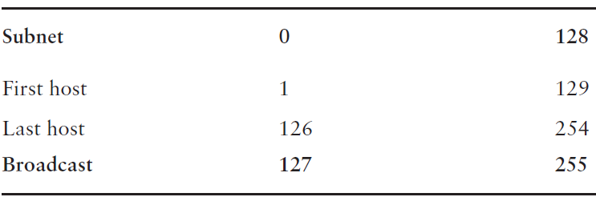
Example (Address Class C)
What’s the broadcast address for each subnet?
The number right before the value of the next subnet is all host bits turned on and equals the broadcast address
For the zero subnet, the next subnet is 128, so the broadcast of the 0 subnet is 127
What are the valid hosts?
These are the numbers between the subnet and broadcast Address
Reference: Lammle, Todd. CCNA Routing and Switching Complete Study Guide: Exam 100-105, John Wiley & Sons, 2016

Slide 53
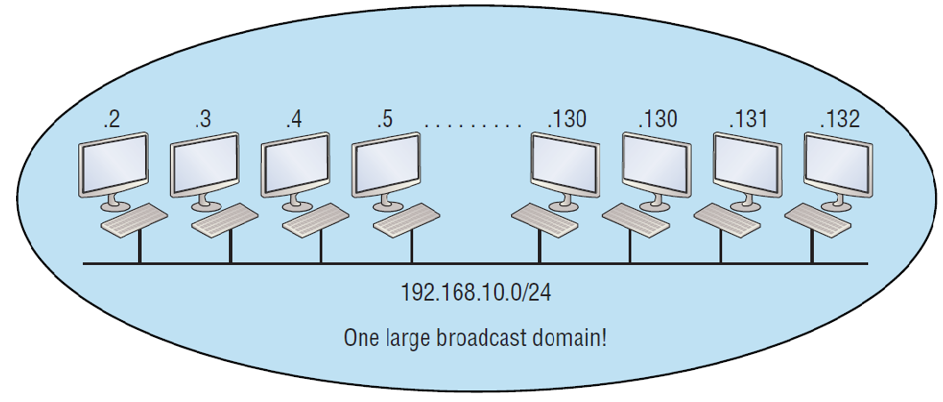
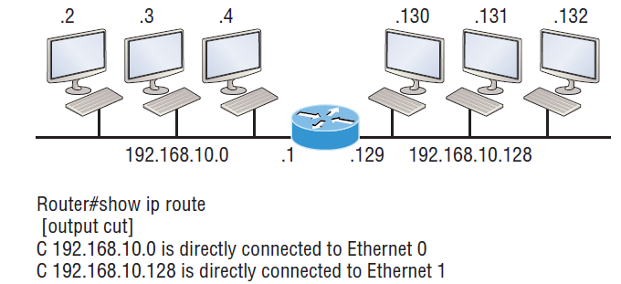
Implementing a Class C /25 logical network
One network
Multiple networks connected together
Reference: Lammle, Todd. CCNA Routing and Switching Complete Study Guide: Exam 100-105,John Wiley & Sons, 2016

Slide 54
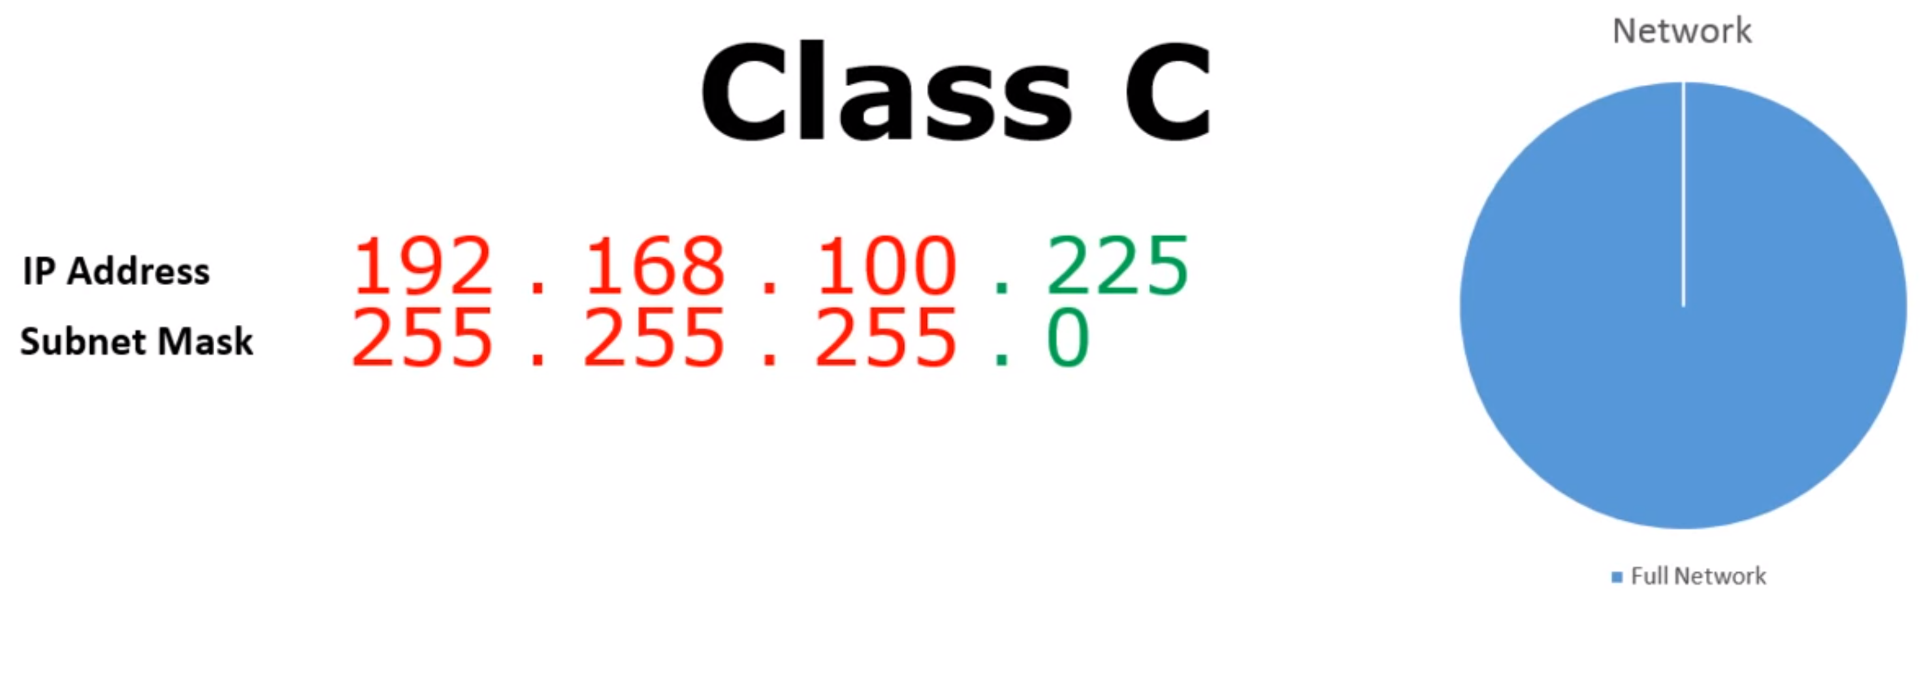
Subnetting: Example1

Slide 55
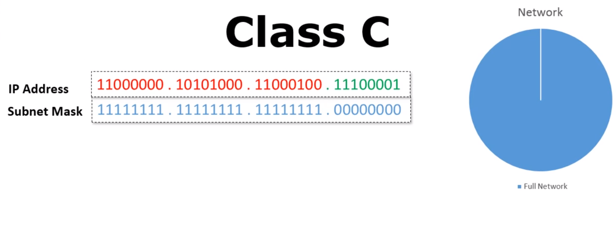
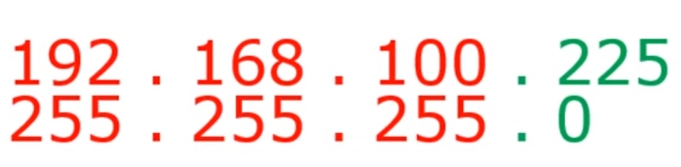
Subnetting: Example1
11111111
254 Hosts
2^8 - 2 = 254 Hosts
Network ID: 192.168.100.0
Broadcast ID: 192.168.100.255

Slide 56
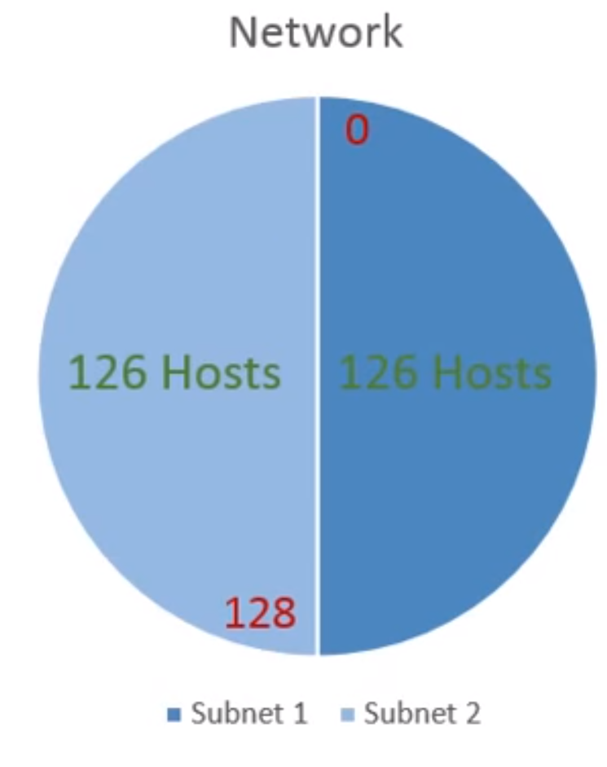
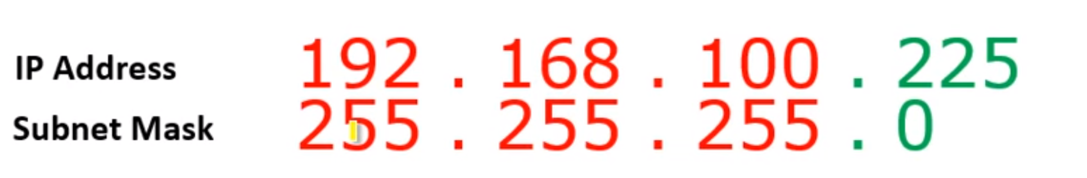
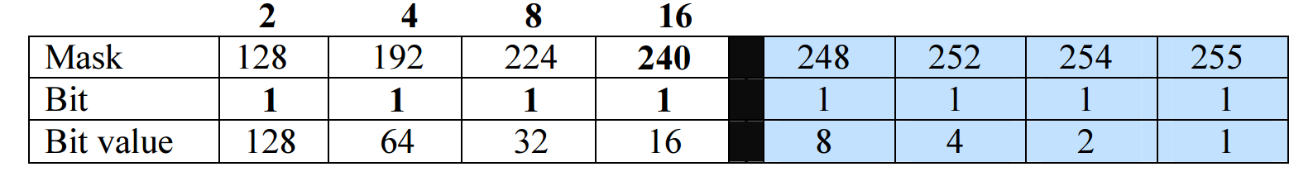
Subnetting: Example1
11111111 . 11111111 . 11111111 . 00000000
11111111 . 11111111 . 11111111 . 10000000
subnet number
host number

Slide 57
Subnetting: Example1
11111111 . 11111111 . 11111111 . 00000000
11111111 . 11111111 . 11111111 . 10000000
Network ID 1: 192.168.100.0
/25
Broadcast ID 1: 192.168.100.127
/25
Network ID 2: 192.168.100.128
/25
Broadcast ID 1: 192.168.100.255
/25
New Subnet Mask:
255.255.255.128

Slide 58
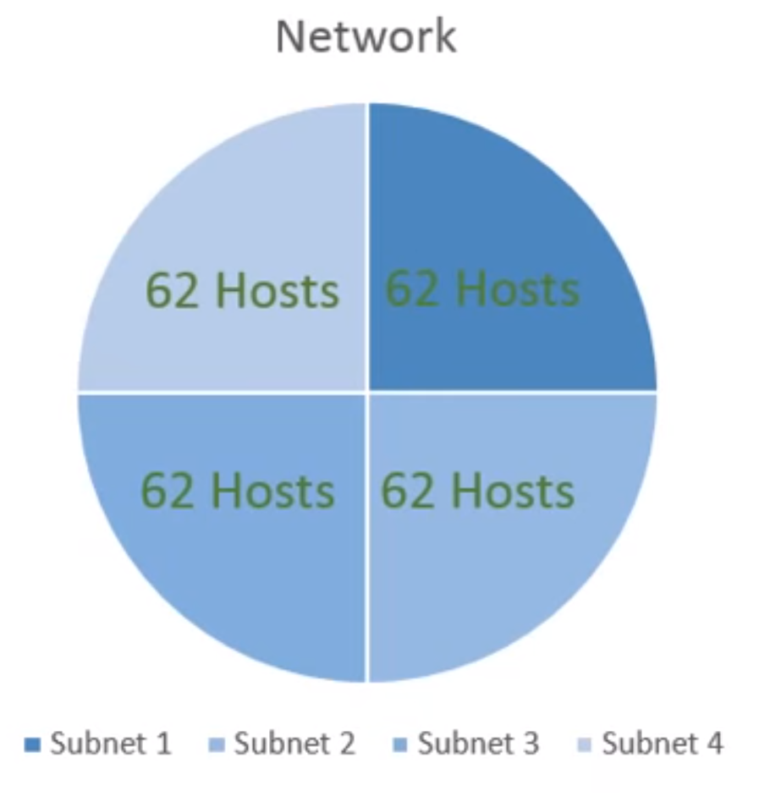
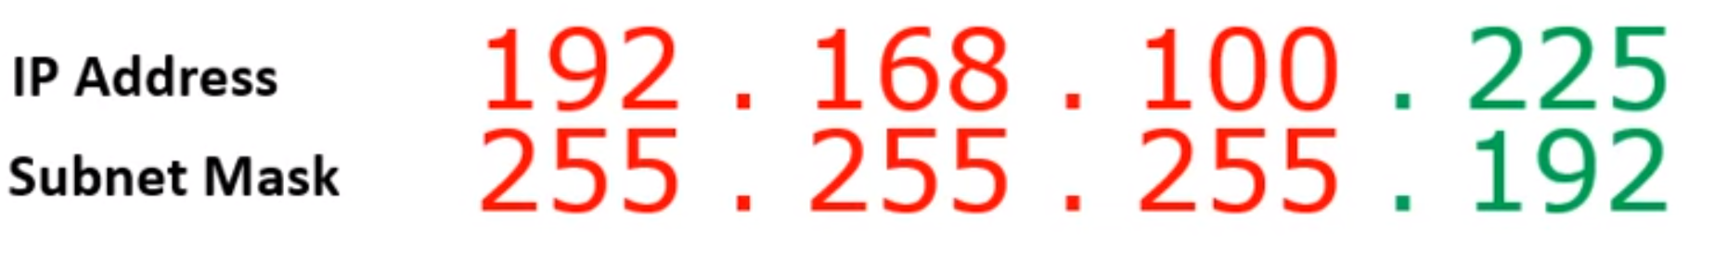
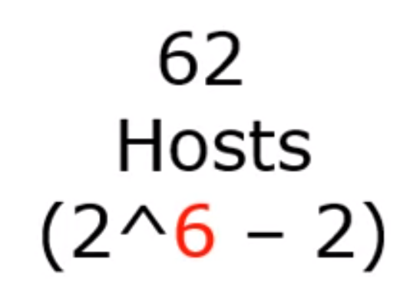
Subnetting Example-2
192 . 168 . 100 . 225/26
OR
11111111 . 11111111 . 11111111 . 11000000

Slide 59
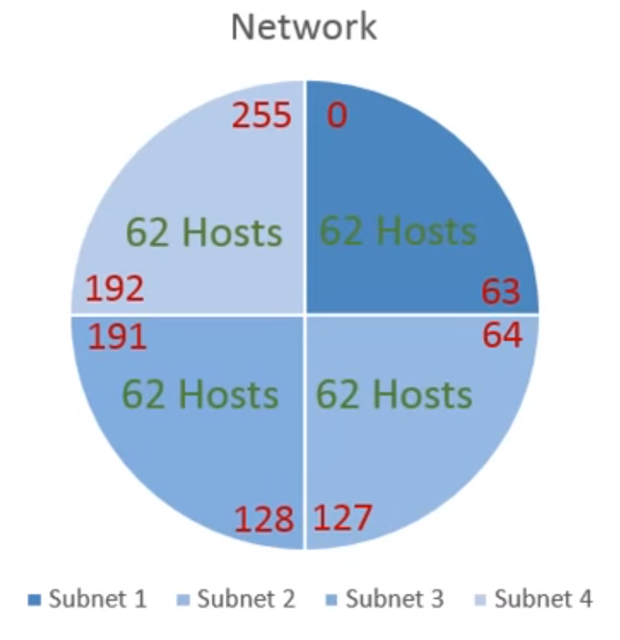
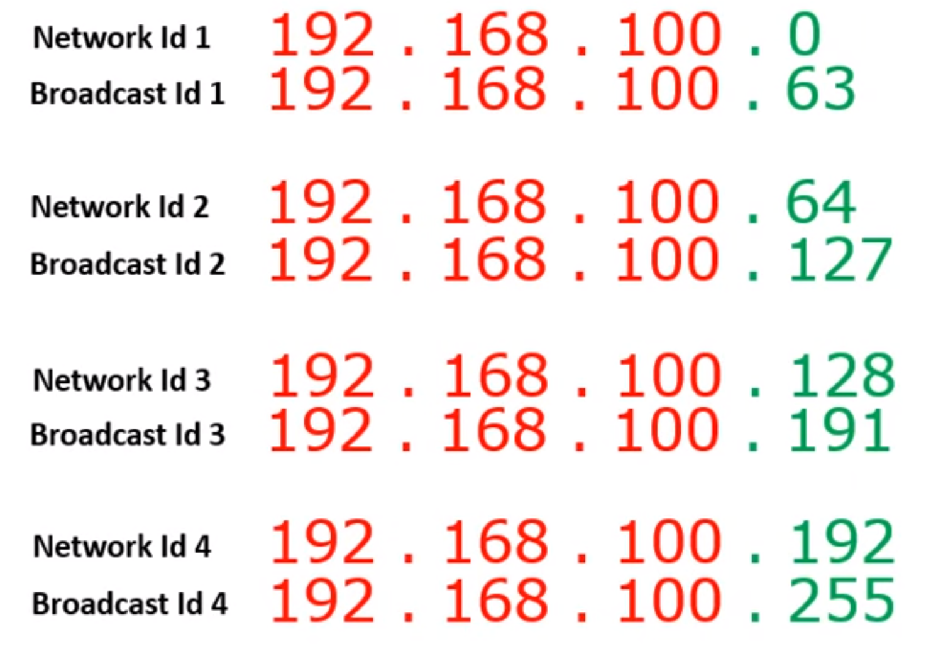
Subnetting
11111111 . 11111111 . 11111111 . 11000000

Slide 60
Our subnet planning mission
We have been assigned an address of 201.222.5.0. Assume 25 subnets are needed, with 5 hosts per subnet. Our mission is to identify each subnet address and the addresses of all hosts under each subnet.
Step 1. Convert the decimal dotted notation address 201.222.5.0/24 to binary:
11001001.11011110.00000101.00000000
Step 2. Determine the Network part of the IP Address 201.222.5.0/24:
201.222.5.0/24 means how many bits for the network?

Slide 61
Step 3. Determine what part of the IP address is the network portion and what part of the address is the host portion:
11001001.11011110.00000101.00000000
Network .Network .Network .Host
Step 4. Determine how many bits you need to borrow from the last octet (host portion) of the IP Address to give you the needed 25 subnets:
2 to the power of 1 = 2 subnets
2 to the power of 2 = 4 subnets
2 to the power of 3 = 8 subnets
2 to the power of 4 = 16 subnets
2 to the power of 5 = 32 subnets
2 to the power of 6 = 64 subnets

Slide 62
Step 5. Since you borrowed five bits from the host for subnets, determine how many hosts can you have on each of those subnets?
2 to the power of 3 = 8 hosts (less 2) giving you 6 hosts per subnet
2^3 - 2 = 6 Hosts/subnet
Notes:
Section G: 15-12-2021

Slide 63
Step 6. Determine the Binary Subnetworks Field Numbers (32 possible combinations):
Subnet # Binary Subnetwork
1 00000
2 00001
3 00010
4 00011
5 00100
6 00101
7 00110
8 00111
9 01000
10 01001
11 01010
12 01011
13 01100
.. ……..
32 11111

Slide 64
Step 7. Determine the Range of Binary Host Field Numbers for Each Subnetwork:
Subnet # Binary Subnetwork Range of Host #’s
1 00000 000 - 111
2 00001 000 - 111
3 00010 000 - 111
4 00011 000 - 111
5 00100 000 - 111
6 00101 000 - 111
7 00110 000 - 111
8 00111 000 - 111
9 01000 000 - 111
10 01001 000 - 111
11 01010 000 - 111
12 01011 000 - 111
13 01100 000 - 111
.. …….. -----------
32 11111 000 - 111
Original IP:
11001001.11011110.00000101.XXXXX000
to
11001001.11011110.00000101.XXXXX111

Slide 65
Step 8. Determine Decimal Host Numbers for Each Subnetwork:
Subnet # Binary Subnetwork Range of Host #’s Decimal Host Numbers
1 00000 000 – 111 .0 - .7
2 00001 000 - 111 .8 - .15
3 00010 000 - 111 .16 - .23
4 00011 000 - 111 .24 - .31
5 00100 000 - 111 .32 - .39
6 00101 000 - 111 .40 - .47
7 00110 000 - 111 .48 - .55
8 00111 000 - 111 .56 - .63
9 01000 000 - 111 .64 - .71
10 01001 000 - 111 .72 - .79
11 01010 000 - 111 .80 - .87
12 01011 000 - 111 .88 - .95
13 01100 000 - 111 .96 - 103
.. …….. ----------- ----------
32 11111 000 - 111 .248 - 255

Slide 66
Step 9. Determine Our Subnet Addresses:
# Binary Subnetwork Range of Host #’s Decimal Host #’s Subnet Address
1 00000 000 - 111 .0 - .7 201.222.5.0
2 00001 000 - 111 .8 - .15 201.222.5.8
3 00010 000 - 111 .16 - .23 201.222.5.16
4 00011 000 - 111 .24 - .31 201.222.5.24
5 00100 000 - 111 .32 - .39 201.222.5.32
6 00101 000 - 111 .40 - .47 201.222.5.40
7 00110 000 - 111 .48 - .55 201.222.5.48
8 00111 000 - 111 .56 - .63 201.222.5.56
9 01000 000 - 111 .64 - .71 201.222.5.64
10 01001 000 - 111 .72 - .79 201.222.5.72
11 01010 000 - 111 .80 - .87 201.222.5.80
12 01011 000 - 111 .88 - .95 201.222.5.88
13 01100 000 - 111 .96 - 103 201.222.5.96
.. .……. ----------- ---------- ---------------
32 11111 000 – 111 .248 – 255 201.222.5.248

Slide 67
Step 10. Determine Host Addresses of the Six Nodes of Each Subnet:
# Subnetwork Range of Host #’s Decimal Host #’s Subnet Address Host Address Range
1 00000 000 – 111 .0 - .7 201.222.5.0 201.222.5.1 thru 201.222.5.6
2 00001 000 - 111 .8 - .15 201.222.5.8 201.222.5.9 thru 201.222.5.14
3 00010 000 - 111 .16 - .23 201.222.5.16 201.222.5.17 thru 201.222.5.22
4 00011 000 - 111 .24 - .31 201.222.5.24 201.222.5.25 thru 201.222.5.30
5 00100 000 - 111 .32 - .39 201.222.5.32 201,222,5,33 thru 201.222.5.38
6 00101 000 - 111 .40 - .47 201.222.5.40 201.222.5.41 thru 201.222.5.46
7 00110 000 - 111 .48 - .55 201.222.5.48 201.222.5.49 thru 201.222.5.54
8 00111 000 - 111 .56 - .63 201.222.5.56 201.222.5.57 thru 201.222.5.62
9 01000 000 - 111 .64 - .71 201.222.5.64 201.222.5.65 thru 201.222.5.70
10 01001 000 - 111 .72 - .79 201.222.5.72 201.222.5.73 thru 201.222.5.78
11 01010 000 - 111 .80 - .87 201.222.5.80 201.222.5.81 thru 201.222.5.86
12 01011 000 - 111 .88 - .95 201.222.5.88 201.222.5.89 thru 201.222.5.94
13 01100 000 - 111 .96 - 103 201.222.5.96 201.222.5.97 thru 201.222.5.--
.. .……. ----------- ---------- --------------- -------------------------------------
32 11111 000 - 111 . 248- 255 201.222.5.248 201.222.5.249 thru 201.222.5.254

Slide 68
Step 11. Determine Broadcast Addresses of Each Subnet:
Range of Decimal Subnet Host Broadcast
# Subnetwork Host #’s Host #’s Address Address Range Address
1 00000 000 – 111 .0 - .7 201.222.5.0 201.222.5.1 thru 201.222.5.6 201.222.5.7
2 00001 000 - 111 .8 - .15 201.222.5.8 201.222.5.9 thru 201.222.5.14 201.222.5.15
3 00010 000 - 111 .16 - .23 201.222.5.16 201.222.5.17 thru 201.222.5.22 201.222.5.23
4 00011 000 - 111 .24 - .31 201.222.5.24 201.222.5.25 thru 201.222.5.30 201.222.5.31
5 00100 000 - 111 .32 - .39 201.222.5.32 201,222,5,33 thru 201.222.5.38 201.222.5,39
6 00101 000 - 111 .40 - .47 201.222.5.40 201.222.5.41 thru 201.222.5.46 201.222.5.47
7 00110 000 - 111 .48 - .55 201.222.5.48 201.222.5.49 thru 201.222.5.54 201.222.5.55
8 00111 000 - 111 .56 - .63 201.222.5.56 201.222.5.57 thru 201.222.5.62 201.222.5.63
9 01000 000 - 111 .64 - .71 201.222.5.64 201.222.5.65 thru 201.222.5.70 201.222.5.71
10 01001 000 - 111 .72 - .79 201.222.5.72 201.222.5.73 thru 201.222.5.78 201.222.5.79
11 01010 000 - 111 .80 - .87 201.222.5.80 201.222.5.81 thru 201.222.5.86 201.222.5.87
12 01011 000 - 111 .88 - .95 201.222.5.88 201.222.5.89 thru 201.222.5.94 201.222.5.95
13 01100 000 - 111 .96 - 103 201.222.5.96 201.222.5.97 thru 201.222.5.-- ----------------
.. .……. ----------- ---------- --------------- ------------------------------------- ----------------
32 11111

Slide 69
Step 12. Determine the subnet mask for network 201.222.5.0 (remember that 5 bits were borrowed):
11111111.11111111.11111111.11111 000
Network Network Network Subnet Host
A data frame with a destination IP Address of 201.222.5.21 would be used by the router, along with the submask of 255.255.255.248, to determine the correct subnet to switch the data to in the switching process:

Slide 70
“ANDING” Process Performed by Router
IP Address: 11001001.11011110.00000101.00010101
Subnet Mask: 11111111.11111111.11111111.11111000
Subnet: 11001001.11011110.00000101.00010000
(Subnet in Decimal Dotted Notation: 201.222.5.16)

Slide 71
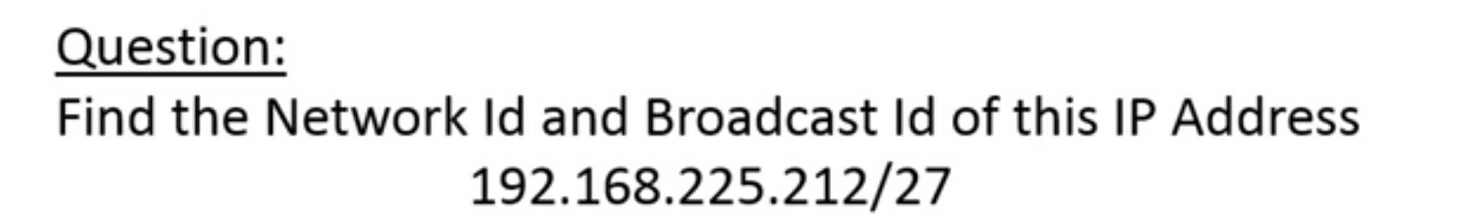
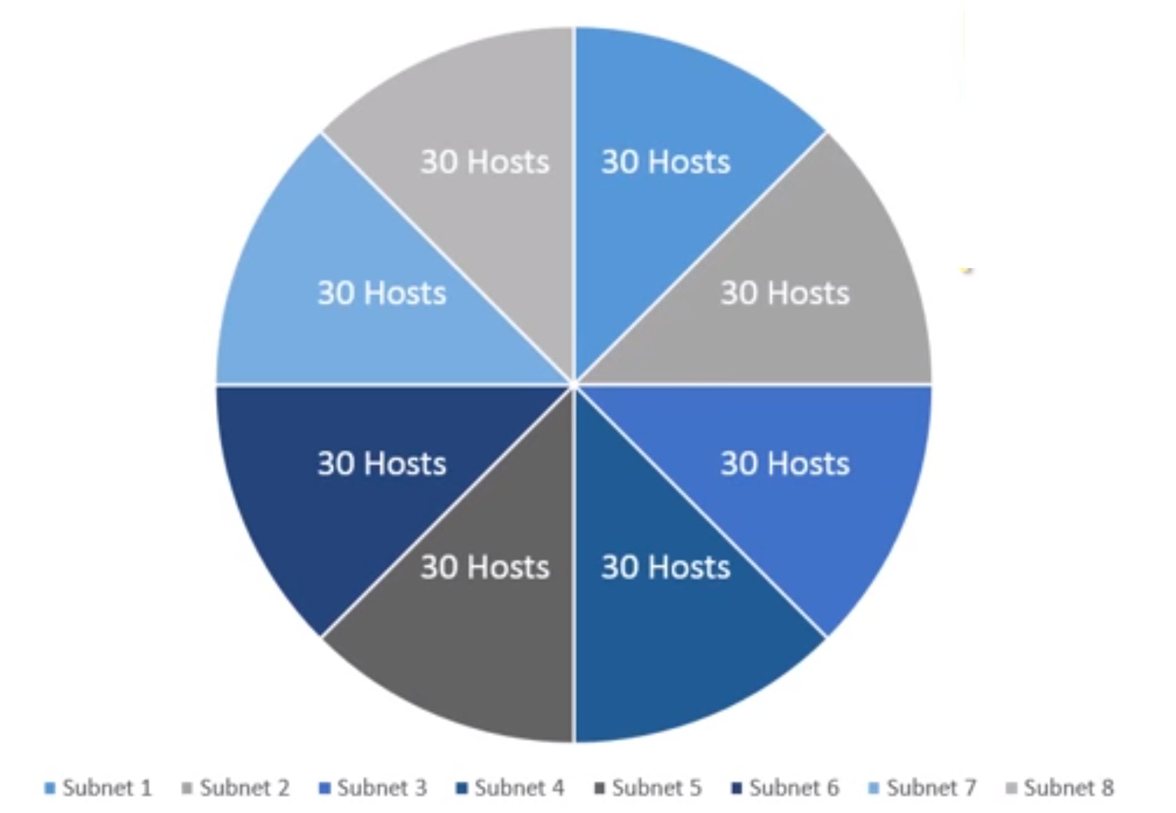
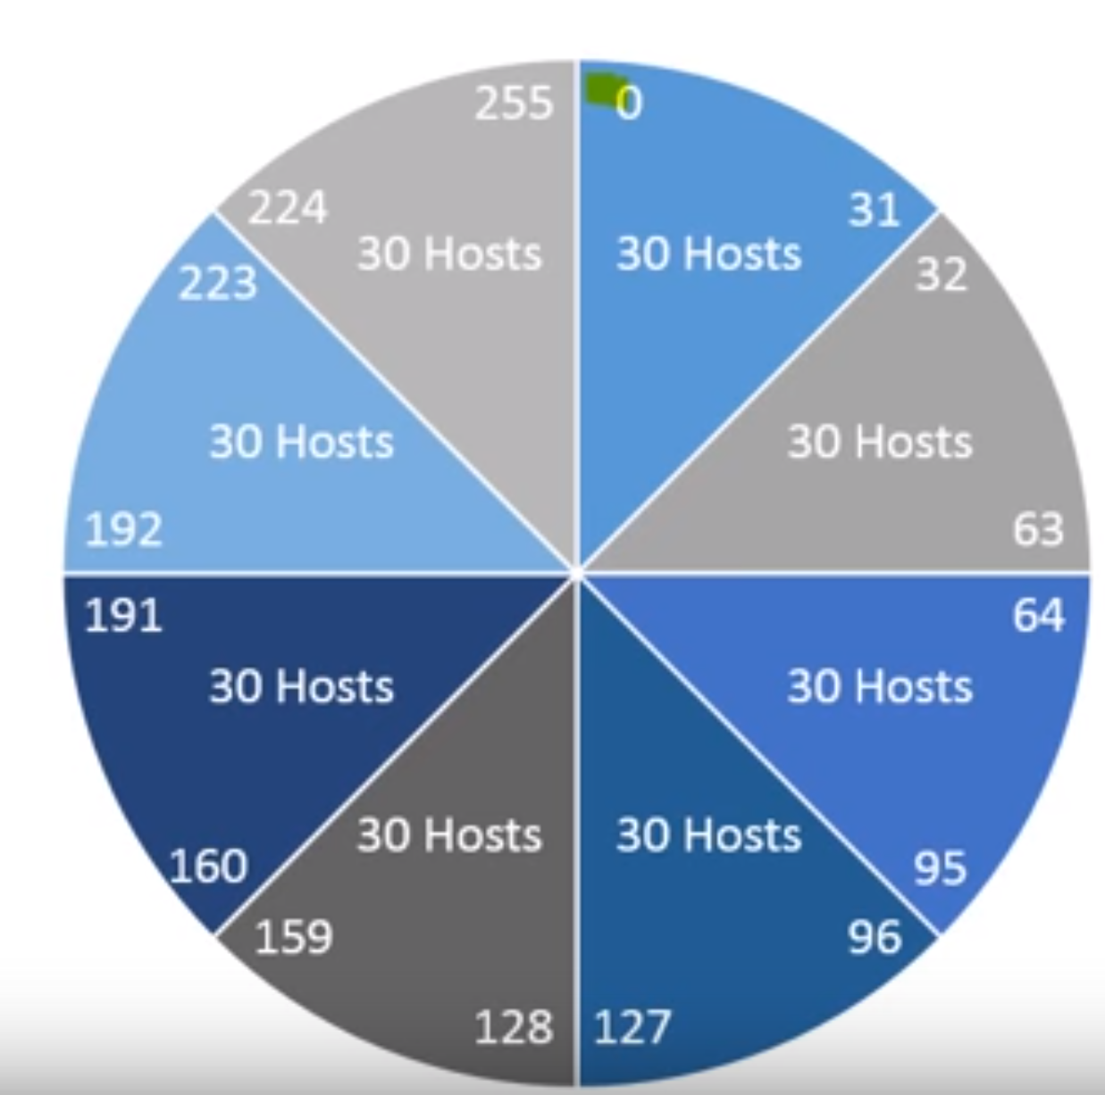
Also, figure out the number of subnets and
number of usable hosts in each subnet
Subnetting Calculator and Learning tutorial: (1) https://subnetipv4.com/ (2) https://subnetipv4.com/#learn
Notes:
Section D: 15-12-2021

Slide 72
Example1
Group size | 128 | 64 | 32 | 16 | 8 | 4 | 2 | 1
S. mask | 128 | 192 | 224 | 240 | 248 | 252 | 254 | 255
CIDR | /25 | /26 | /27 | /28 | /29 | /30 | /31 | /32
Subnetting of: 10.1.1.55 /28or Subnet mask: 255.255.255.240
Information needed | Detail | IP addresses
Network ID | First IP address in each Network | 10.1.1.48
Broadcast IP | Last IP address in each Network | 10.1.1.63
First Host IP | IP address after the Network ID | 10.1.1.49
Last Host IP | IP address before the Broadcast IP | 10.1.1.62
Next Network | IP address after the Broadcast IP | 10.1.1.64
IP Address | Number of IP addresses in each Network | 16
CIDR/subnet | Converting between CIDR/subnet Mask | 255.255.255.240
Subnetting Calculator and Learning tutorial: (1) https://subnetipv4.com/ (2) https://subnetipv4.com/#learn

Slide 73
Practice Example Class-B: 255.255.128.0 (/17)
Network address: 172.16.0.0
Subnet mask: 255.255.128.0
How many subnets?
Subnets = 2 = 2 = 2
How many hosts per subnet?
Hosts per subnet = 2 -2= 2 – 2 = 32,766 (7 bits in the third octet, and 8 in the fourth)
Valid subnets? 256 – 128 = 128.
0 and 128: (Remember that subnetting is performed in the third octet, so the subnet numbers are really 0.0 and 128.0)
x
1
y
15

Slide 74
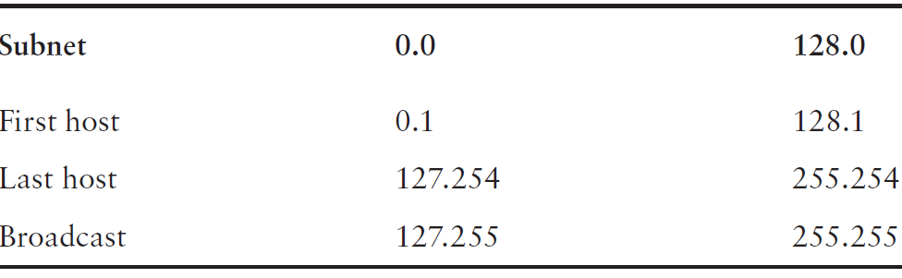
Broadcast addresses and valid hosts
Broadcast address for each subnet?
Valid hosts?

Slide 75
Practice Example Class-A: 255.255.0.0 (/16)
Network address: 10.0.0.0
Subnet mask: 255.255.0.0
How many subnets?
Subnets = 2 = 2 = 256
How many hosts per subnet?
Hosts per subnet = 2 = 2 – 2 = 65534
Valid subnets? Group size: 2= 2 =65536
The subnets would be 10.0.0.0, 10.1.0.0, 10.2.0.0, 10.3.0.0, etc., up to 10.255.0.0
x
8
y
16
y
16
Notes:
Section E: covered: 17.12.2021

Slide 76
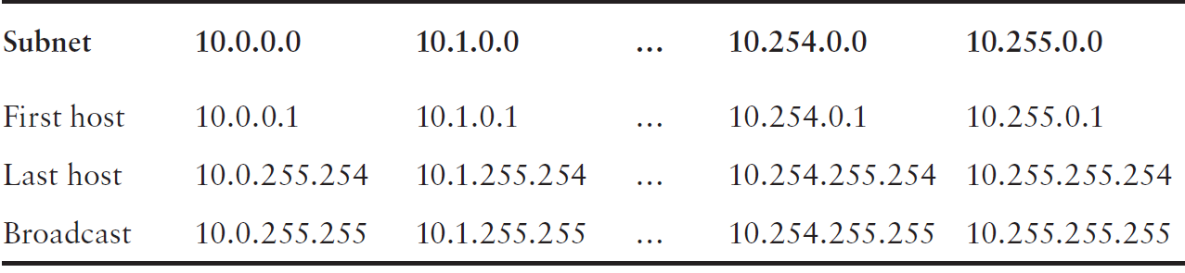
Broadcast addresses and valid hosts
Broadcast address for each subnet?
Valid hosts?

Slide 77
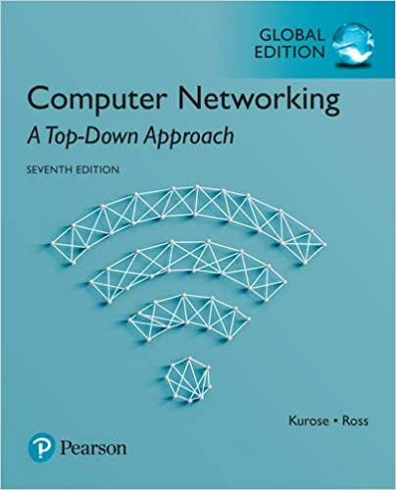

Thank You All
☺
?
A note on the origin of these ppt slides:
All material copyright 1996-2020 J.F Kurose and K.W. Ross, All Rights Reserved
These slides are freely provided by the book authors and it represents a lot of work on their part. We would like to thank J.F Kurose and K.W. Ross.
Transport Layer: 3-150
Notes:
Section F and G ended

